Slide 1
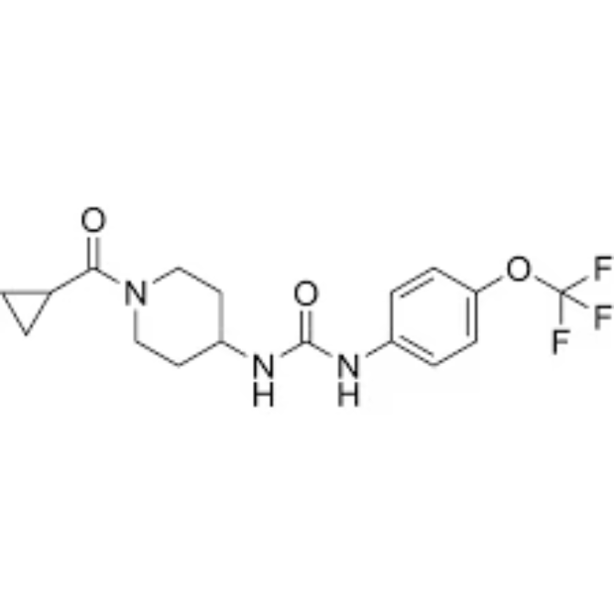
FINAL YEAR PROJECT
Web-Based QSAR Modeling for Bioactivity Prediction of Soluble Epoxide Hydrolase (sEH) Inhibitors
Predicting Soluble Epoxide Hydrolase Inhibitor Potency
M.Ramana Maharshi
Final Year Bioinformatics
Semester: 4.2
Guide: Abraham Sir
Vignan University

Slide 2
Background: Why Target sEH?
The Problem
Our Solution
• sEH degrades anti-inflammatory EETs • Implicated in multiple diseases • Traditional discovery: slow & expensive
• ML: 10-100× faster screening • QSAR: Predict from structure • Cost-Effective: $0-300 vs $1M+

Slide 3
Research Objectives
1
Compile high-quality dataset from ChEMBL (2,000-3,500 compounds)
2
Engineer comprehensive molecular descriptors (2,200+ features)
3
Train and compare 10 ML algorithms
4
Rigorous validation (CV, test set, Y-randomization)
5
Interpret results with SHAP analysis

Slide 4
Methodology Overview
Data Collection
Features
ML Training
Preprocessing
→
→
2D descriptors
Fingerprints
~2,200 features
ChEMBL
IC50 values
~2,500 compounds
Quality control
pIC50 calc
De-dup
→
10 algorithms
70/15/15 split
Optimization
→
Deployment
Validation
→
Web-based deployment using Streamlit
Cross-validation
Test set
SHAP

Slide 5
Dataset Characteristics
Summary Statistics
Total compounds: 2,542
pIC50 range: 4.2 - 10.5
Mean ± SD: 7.1 ± 1.3
Median: 7.2
Bioactivity data collected for sEH inhibitors
IC₅₀ / pIC₅₀ used as target variable
Dataset cleaned and converted into ML-ready format

Slide 6
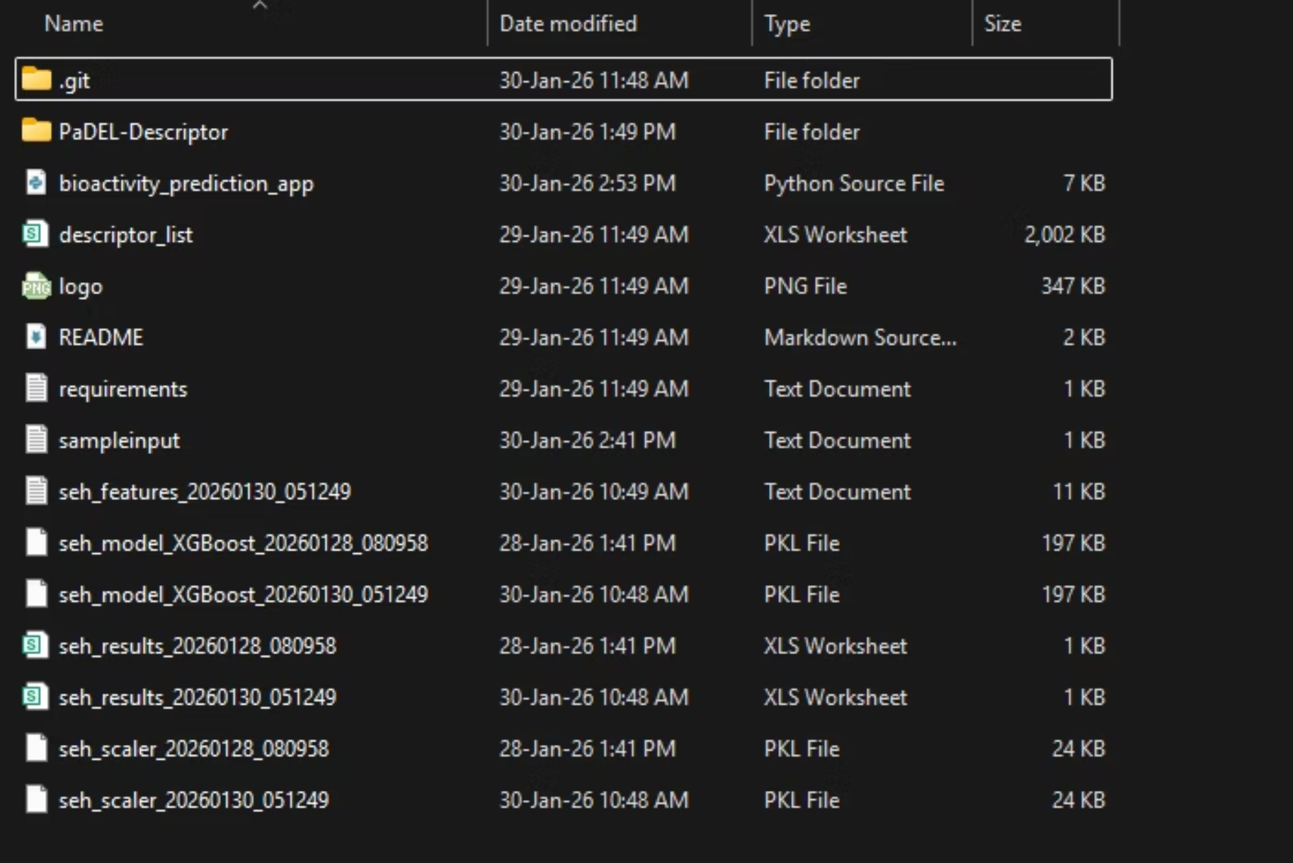
Dataset Collection
Bioactivity data collected for sEH inhibitors
IC₅₀ / pIC₅₀ used as target variable
Dataset cleaned and converted into ML-ready format

Slide 7
Machine Learning Models Evaluated
Classical Models
Ensemble Models
• Ridge Regression
• Lasso Regression
• Elastic Net
• SVR
• KNN
• Random Forest
• Gradient Boosting
• XGBoost
• LightGBM
• CatBoost

Slide 8
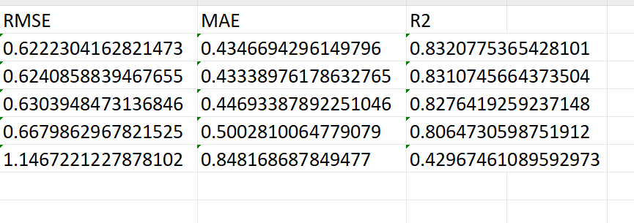
Results: Model Performance
🥇 #1 XGBoost
R² = 0.82
🥇 #1 XGBoost
R² = 0.82
🥈 #2 LightGBM
R² = 0.81
🥉 #3 CatBoost
R² = 0.80

Slide 9
Feature Importance: SHAP Analysis
Top Predictors
1. LogP - Lipophilicity
2. Molecular Weight
3. H-Bond Acceptors
4. Aromatic Rings
5. TPSA
SHAP (SHapley Additive exPlanations) is a game-theory-based method used to interpret machine learning models by assigning an importance value to each feature for a specific prediction

Slide 10
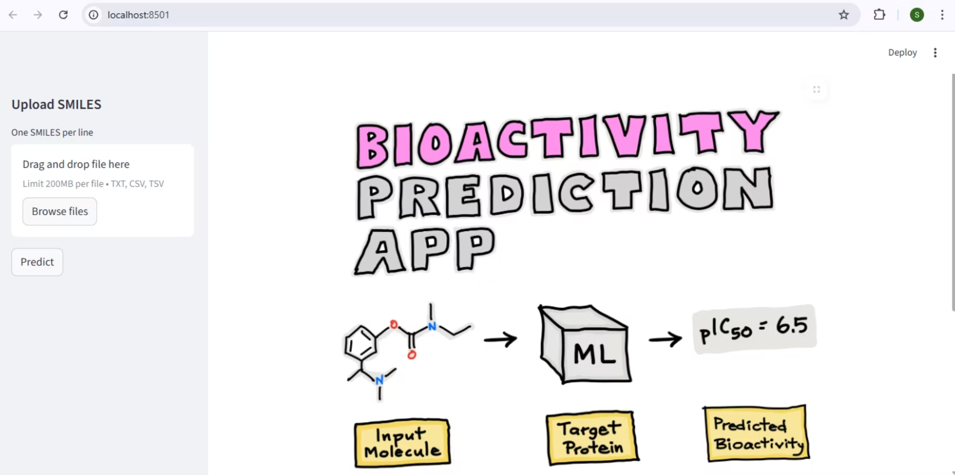
Deployment of Web-Based Application
Predicted Bioactivity
Values generated for test molecules.
Data Storage
Results stored efficiently in Excel format.
Model Efficacy
Model successfully predicts unseen compounds.
The focus of this phase was pipeline development and prediction capability.

Slide 11
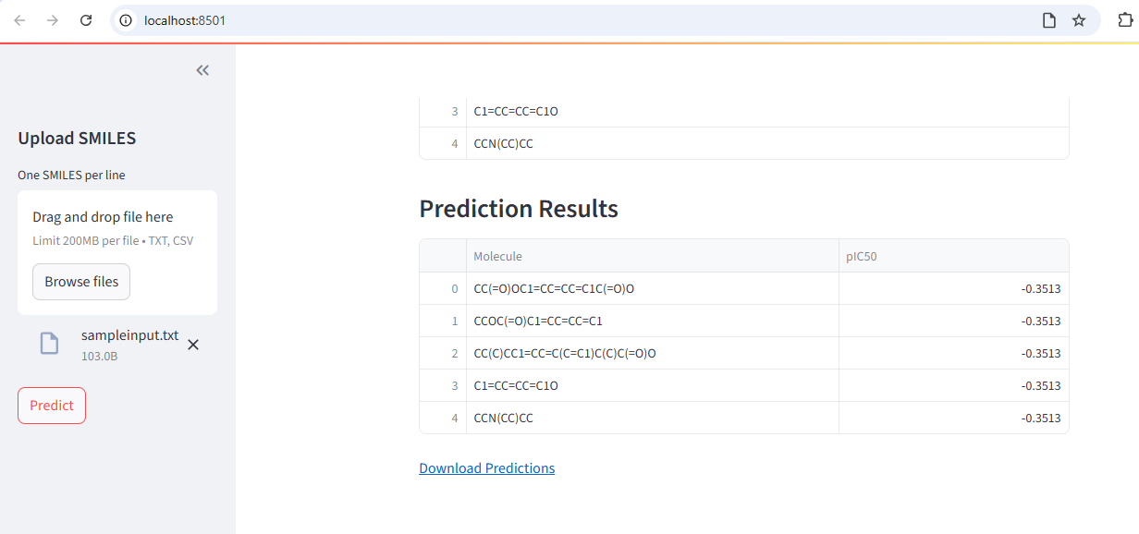
Testing with smaller input smiles

Slide 12
Validation & Impact
Comprehensive Validation
• 5-fold CV (R² = 0.81 ± 0.03) • External test set (15%) • Y-randomization
• Temporal validation • Scaffold splitting • Applicability domain
Scientific Impact
Practical Impact
• Largest sEH QSAR study
• Interpretable SAR insights
• Natural product validation
• 10-100× faster screening
• Cost: $0-300 vs $1M+
• Ready for predictions

Slide 13
Conclusions & Future Directions
Key Conclusions
• XGBoost achieved R² = 0.82 • LogP most critical feature
• Validated across 6 tests • Ready for virtual screening
Enhanced Analysis
Target Journals
• Molecular Docking (500)
• MD Simulations (100×200ns)
• FEP (top 30)
• Novel AI (GNN, PINN)
• J Chem Inf Model (IF 5.6)
• Mol Pharmaceutics (IF 4.5)
• Comp Struct Biotech (IF 6.0)

Slide 14
Updated pipeline (Implementing Further Validation)
Dataset Collection Collected ~2,500 sEH inhibitor compounds with IC₅₀ data from the ChEMBL database.
Data Preprocessing
Cleaned the dataset and converted IC₅₀ values to pIC₅₀ for machine learning modeling.
Descriptor Generation Generated ~2200 molecular descriptors and fingerprints using RDKit.
QSAR Model Development
Trained multiple machine learning models to predict inhibitor potency.
Virtual Screening Screened compound libraries using the trained QSAR model to predict bioactivity.
Docking & ADMET Filtering
Performed molecular docking and applied drug-likeness filters to shortlist promising compounds.
MD Simulation Preparation
Selected top candidate inhibitors and prepared them for molecular dynamics simulations.
1
2
3
4
5

Slide 15
Achieved Progress
Collected sEH inhibitor dataset from ChEMBL.
Generated ~2200 molecular descriptors.
Developed QSAR model for pIC50 prediction.
Performed virtual screening of compound library.
Identified top candidate inhibitors using docking and ADMET filters.
Prepared top hits for molecular dynamics simulations

Slide 16
Achieved Progress
QSAR model successfully trained and validated.
XGBoost selected as best model and used for large-scale virtual screening.
Prediction results exported for downstream analysis.
Output Files
seh_model_XGBoost_*.pkl
seh_cv_results_*.csv
seh_metrics_*.json

Slide 17
Virtual Screening Progress
Virtual Screening of Compound Library
Trained QSAR model used to screen compound library
Bioactivity predictions generated for all compounds
Compounds ranked based on predicted pIC50
Output Files
Outcome
step1_all_predictions.csv
step2_top100_qsar.csv
Top 100 compounds shortlisted for docking analysis.

Slide 18
Molecular Docking Results
Docking Analysis
Docking performed against sEH protein structure (PDB: 3ANS)
Docking executed using AutoDock Vina
Binding affinity calculated for shortlisted compounds
Output File
Outcome
step3_docking_results.csv
Compounds were ranked based on docking score and strong binding interactions were identified for top hits.

Slide 19
ADMET Filtering Analysis
Drug-Likeness and ADMET Filtering
Drug-Likeness Filters Applied
Lipinski Rule of Five
Veber Rule
PAINS filters
Brenk alerts
Synthetic accessibility
Output File
Outcome
step4_admet_filtered.csv
Compounds passing ADMET filters were selected and ranked using a composite scoring scheme.

Slide 20
Top Candidate Compounds
Top Predicted sEH Inhibitors
Output File
step4_admet_filtered.csv
These compounds were selected based on high predicted potency (pIC50), strong docking affinity, and favorable ADMET properties.
Top candidates were selected based on predicted potency, docking affinity, and composite ranking.
Compound ID | Predicted pIC50 | Predicted IC50 (nM) | Docking Score (kcal/mol) | Composite Score
CNP0035465.1 | 9.03 | 0.92 | -7.51 | 0.8468
CNP0032988.1 | 8.93 | 1.19 | -7.59 | 0.7749
CNP0036054.1 | 8.86 | 1.40 | -7.63 | 0.7242

Slide 21

Further Required Progress…
Perform molecular dynamics simulations using GROMACS to evaluate binding stability of the top candidate inhibitors (RMSD, RMSF, and hydrogen bond analysis).
GROMACS (GROningen MAchine for Chemical Simulations) is an open-source software package used to perform molecular dynamics simulations of proteins, lipids, and other biomolecular systems.
Protein (sEH – PDB: 3ANS) + Top ligand compound = complex.pdb for GROMACS

Slide 22
Further Required Progress…
Purpose: Evaluate stability of protein–ligand complex.
Software: GROMACS (GROningen MAchine for Chemical Simulations)
Analysis: RMSD,RMSF and Hydrogen bond analysis
Recommended Compounds for MD
• CNP0035465.1
• CNP0032988.1
• CNP0036054.1
Protein (PDB: 3ANS) + ligand → complex.pdb for GROMACS

Slide 23

M. Ramana Maharshi

